Slide 1
Capstone Project Air BnB Team members Bhupendra Singh Ahiwar Chandan Baraliya Abhishek

Slide 2
Project summary
Airbnb, Inc. is an American company that operates an online marketplace for lodging, primarily home stays for vacation rentals, and tourism activities. Based in San Francisco, California, the platform is accessible via website and mobile app.
In this project we are doing analysis based on given data set and tried to find the useful information like, neighbuorhood with respect to listing insights, Density and distribution of prices for each neighborhood group, Various room types in Airbnb NYC and its insights etc. for better understanding of data in order to take better decision for company betterment.

Slide 3
What we will discuss
What can we learn about different hosts and areas?
What can we learn from predictions? (ex: locations, prices, reviews, etc)
Which hosts are the busiest and why?
Is there any noticeable difference of traffic among different areas and what could be the reason for it?

Slide 4
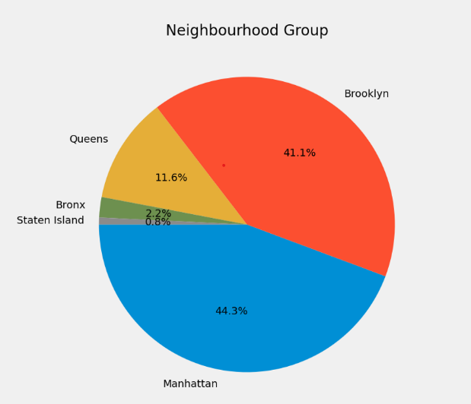
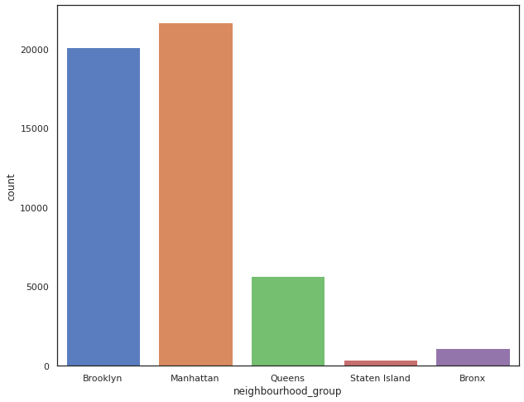
Various Neighbourhood group and its listing insights
Manhattan has the highest number of listing of about 44.3 % followed by Brooklyn of 41%.
State Island stands the least number of listing less the 1 %.

Slide 5
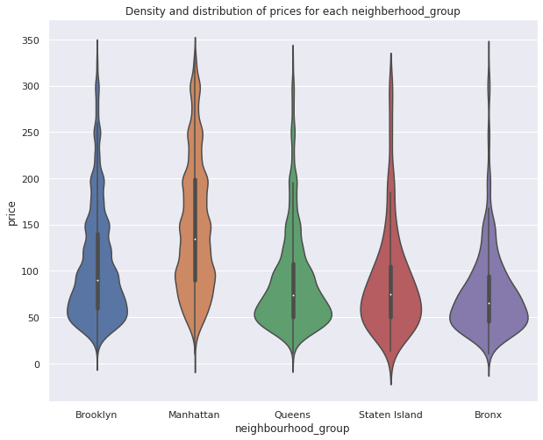
Density and distribution of prices for each neighborhood group
As usual Manhattan being the costliest place to live in NYC, having average price more than 140 USD followed by Brooklyn with around 80 USD on an average for the listings.
Queens and Staten Island has nearly the same of 75 USD.
The highest price range could go just above 360 USD.

Slide 6
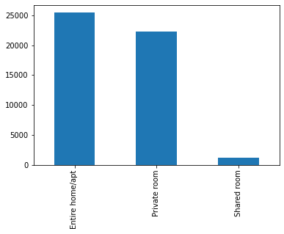
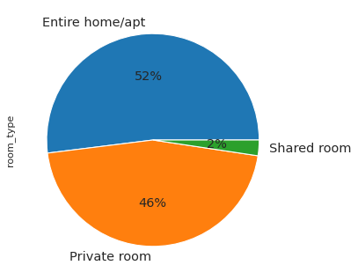
Various room types in Airbnb NYC and its insights
The entire home/apt room are the highest in NYC followed by private rooms.
Shared room holds are only 2 % in Airbnb NYC.

Slide 7
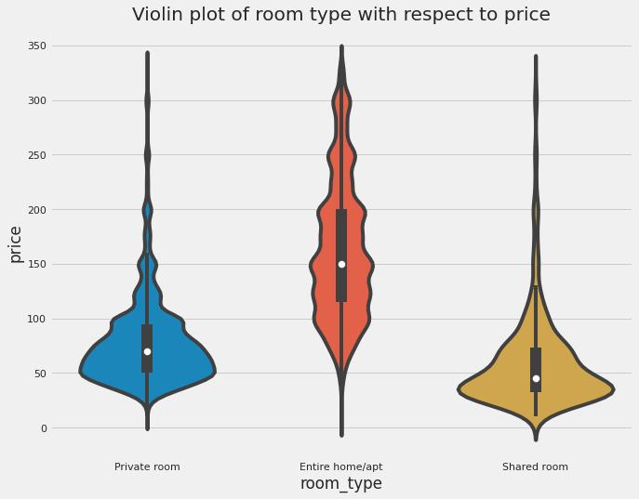
Various average cost of stay in different room types
Entire Home may averagely cost 150 USD .
Private room average cost is of around 65 USD.
Shared rooms cost the least price of less then 50 USD.
So, lets check what people prefer to live in with review counts.

Slide 8
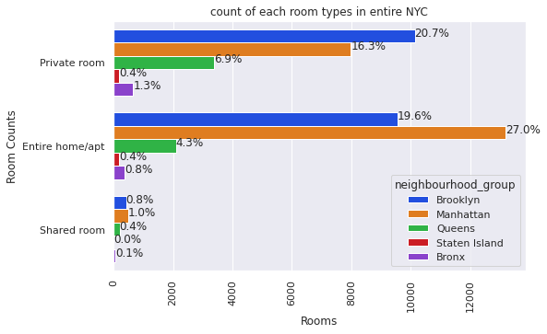
Distribution of Airbnb room types at neighborhood group in NYC
Manhattan has the highest number of Entire home/apt.
Brooklyn holds the top share of private rooms and has opportunity of increase in Entire home.
State island has an equal percentage of Private rooms and Entire home.
Also we see that State island has less number of room types as compared to other neighbourhood. Which matches our neighbourhood group to listing counts.
Bronx has less percentage of Entire home in compare to Private Room and nearly null share rooms.
May we increase private property in Manhattan? Answers people review and cost.

Slide 9
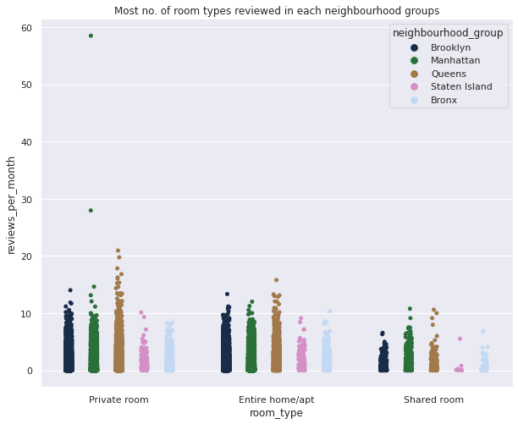
Monthly reviews of room types in each neighbourhood groups.
Here we can conclude that Private rooms in Manhattan Neighborhood group had the highest number of reviews going 50+ reviews per month followed by the chase.
After Manhattan, Queens had the highest number of reviews in all the room types.
There were less reviews received from shared rooms as compared to other room types and it was from Staten Island followed by Bronx.

Slide 10
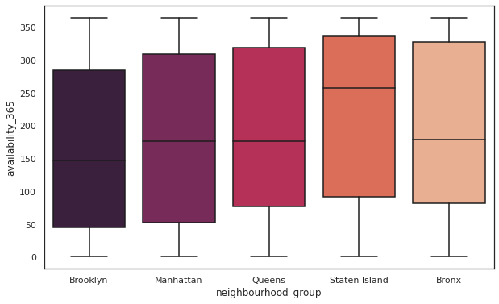
How is the avability of rooms at neighbourhood group
Staten Island has the most avability of rooms all the year.
Brooklyn having the least availability of rooms through a year with the second most count listing gives an opportunity to have an increase in number of rooms.
Manhattan, Bronx and Queens and nearly an equal avability of rooms throughout the year.

Slide 11
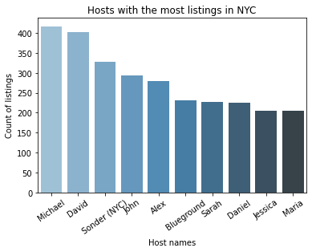
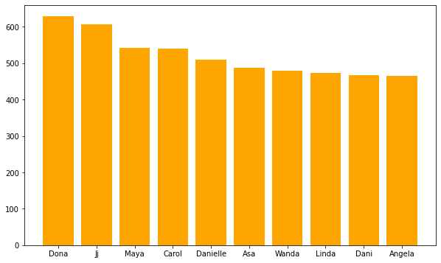
Host with highest number of reviews and Highest list counts
i) Dona, Ji, Maya, Carol, Danielle has the maximum number of reviews.
ii) While Micheal, David, Sonder(NYC), John has the highest number of listing counts.
The being the top faciltors and busiest host.

Slide 12
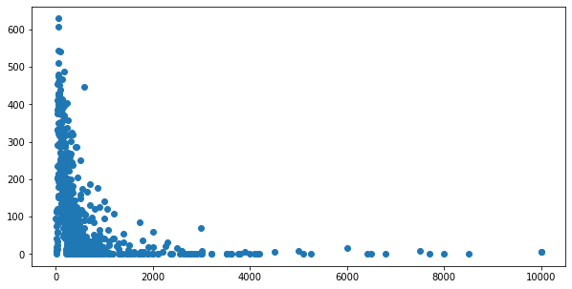
Price vs Reviews
This tThThis graph show that people prefers where price is lessis graph show that people prefers where price is legraph show that people prefers where price is lessThis graph show that people prefers where price is less

Slide 13
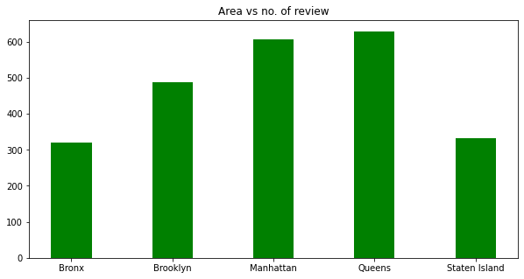
Relation between and reviews
SDSThis graph show that people prefers where price is lessS
From above graph we can know about the reviews of all areas

Slide 14
Conclusions
1-The people who prefer to stay in Entire home or Apartment they are going to stay bit longer in that particular Neighbourhood only.
2-The people who prefer to stay in Private room they won't stay longer as compared to Home or Apartment.
3-Most people prefer to pay less price.
4-If there are more number of Reviews for particular Neighbourhood group that means that place is a tourist place.
5-If people are not staying more then one night means they are travellers.
Thanks

